Slide 1

Programação WEB
Por: Rafael Duarte

Slide 2
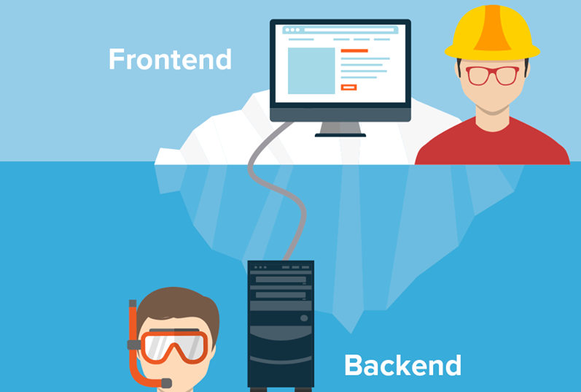
Objetivo
Entender as partes integrantes de um sistema web.
https://medium.com/@larong2122/what-is-back-end-development-d93732c129e9

Slide 3


Slide 4
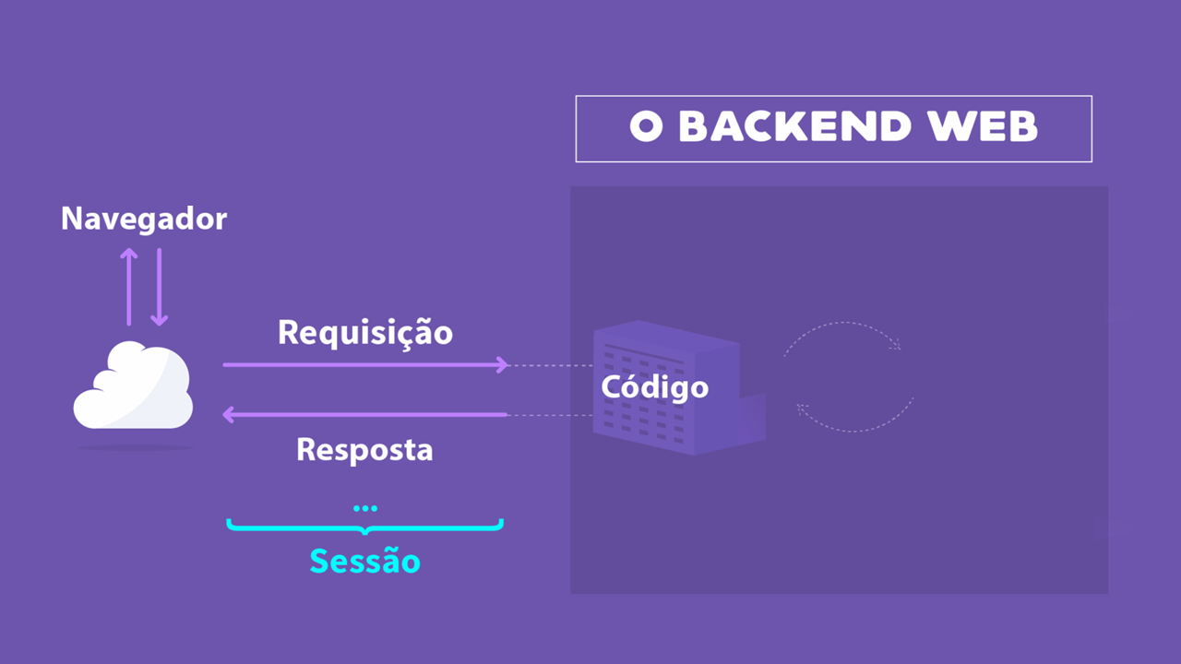


Clientes
INTERNET

Slide 5

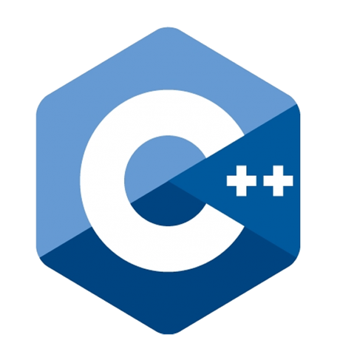

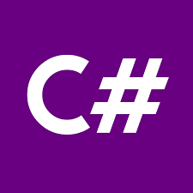





Liguagens backend
https://becode.com.br/principais-linguagens-de-programacao/

Slide 6
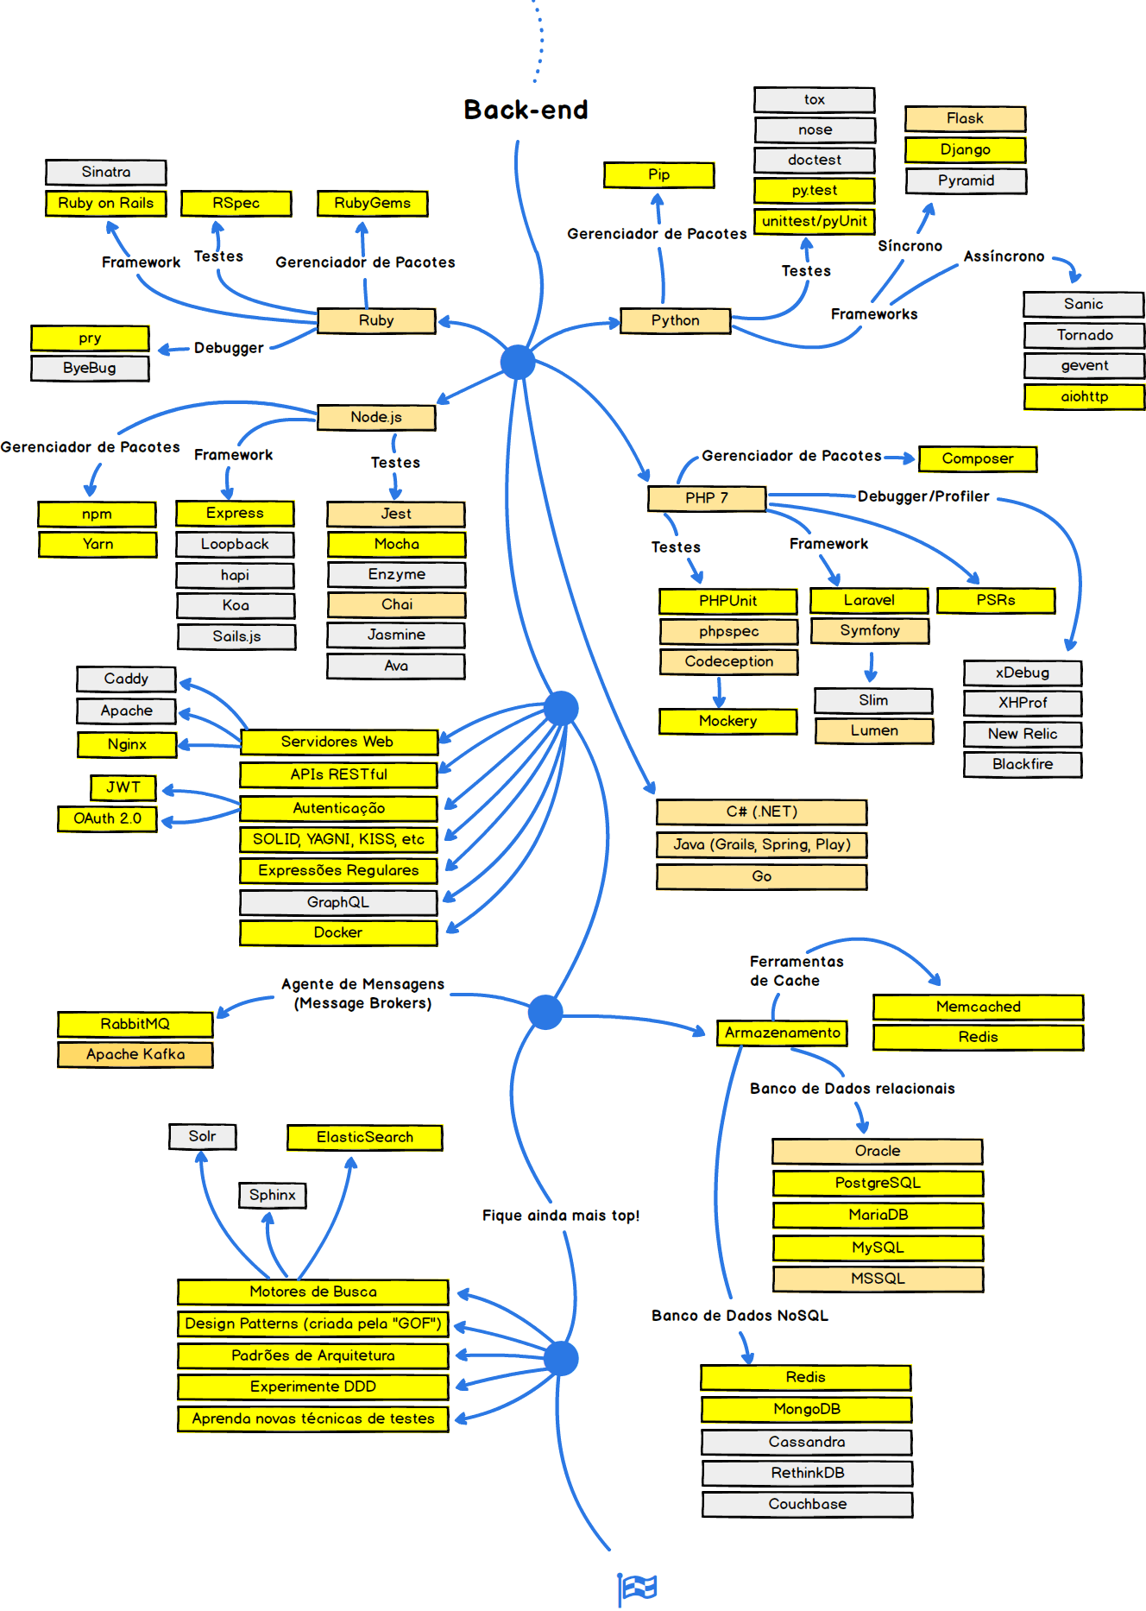

Slide 7






Tecnologias Backend que vamos ver no curso

Slide 8
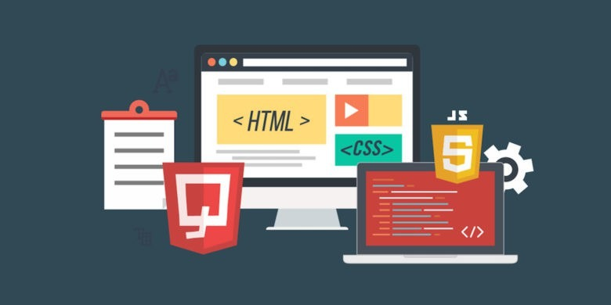
WHAT IS FRONT-END DEVELOPMENT?

Slide 9








Clientes
INTERNET
http://www.matera.com/blog/post/o-que-e-um-front-end-developer
https://frontendmasters.com/books/front-end-handbook/2018/what-is-a-FD.html

Slide 10




Slide 11



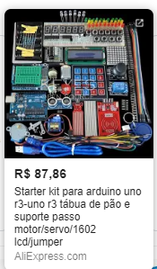



Slide 12
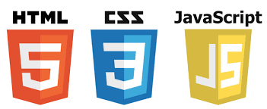

Slide 13
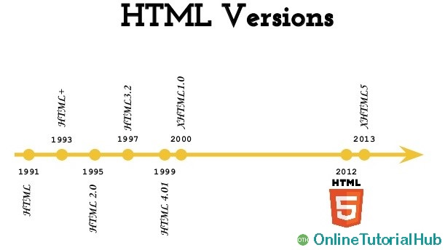

Slide 14
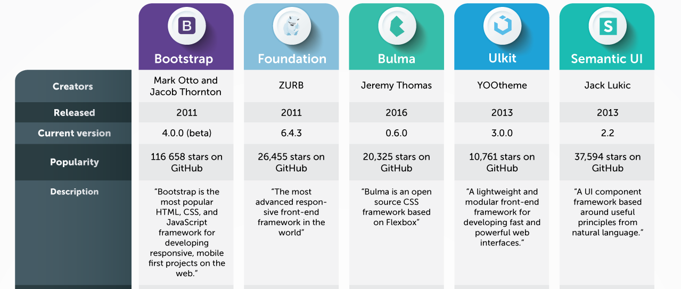
https://hackernoon.com/top-5-most-popular-css-frameworks-that-you-should-pay-attention-to-in-2017-344a8b67fba1

Slide 15
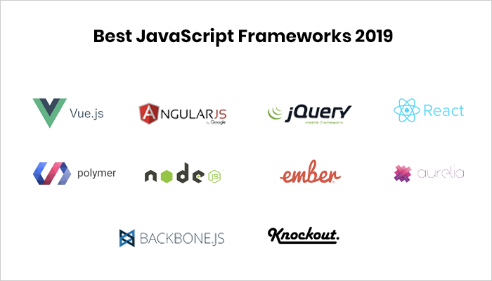
https://freejquery.com/javascript/javascript-frameworks-2019/
https://www.mobileappdaily.com/2018/08/31/guide-on-javascript-frameworks

Slide 16
Linguagens “Fullstack”

Slide 17
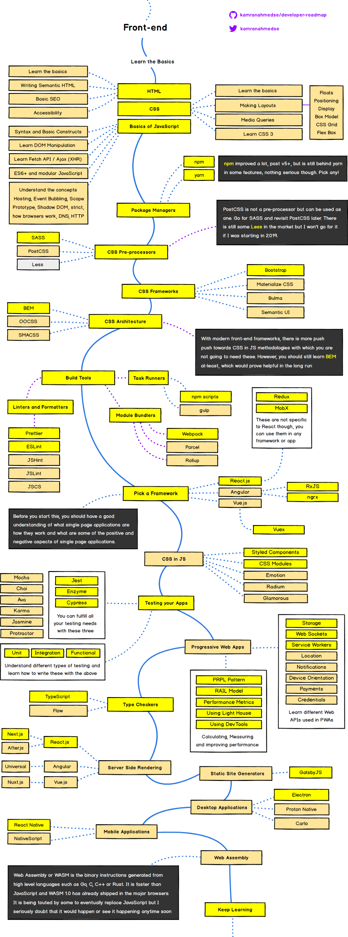
https://hackernoon.com/the-2019-web-developer-roadmap-ab89ac3c380e

Slide 18
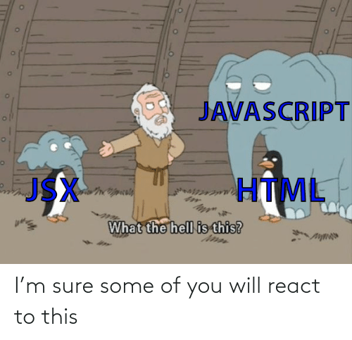

Slide 19


Qual escolher?

Slide 20


E por qual motivo trabalhar com programação WEB?

Slide 21

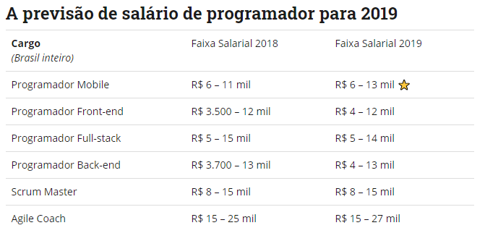

Queremos ser ricos
https://blog.geekhunter.com.br/salario-de-programador-cargos-em-alta-2019/

Slide 22
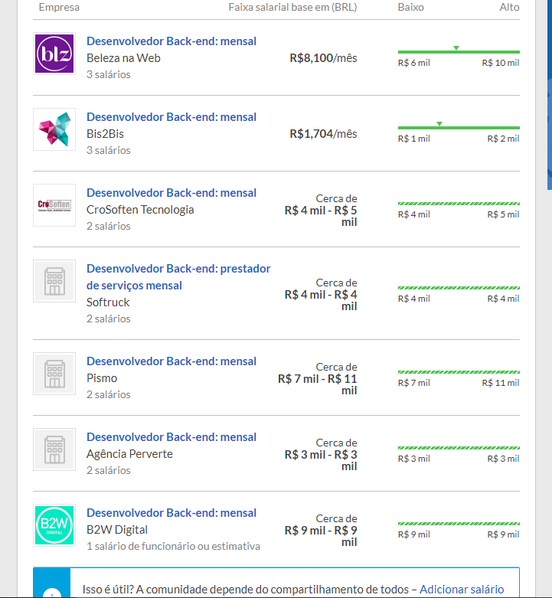
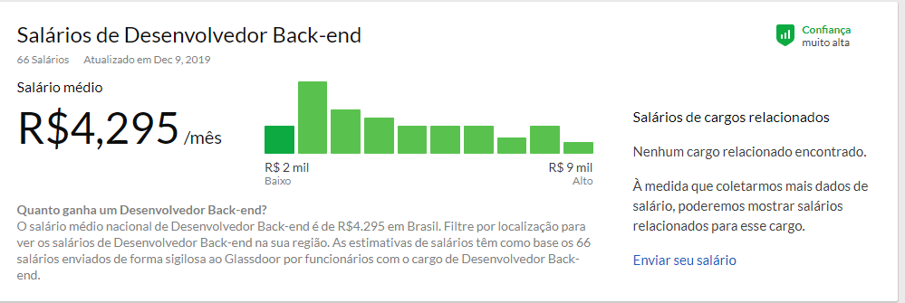
https://www.glassdoor.com.br/Sal%C3%A1rios/desenvolvedor-back-end-sal%C3%A1rio-SRCH_KO0,22.htm

Slide 23
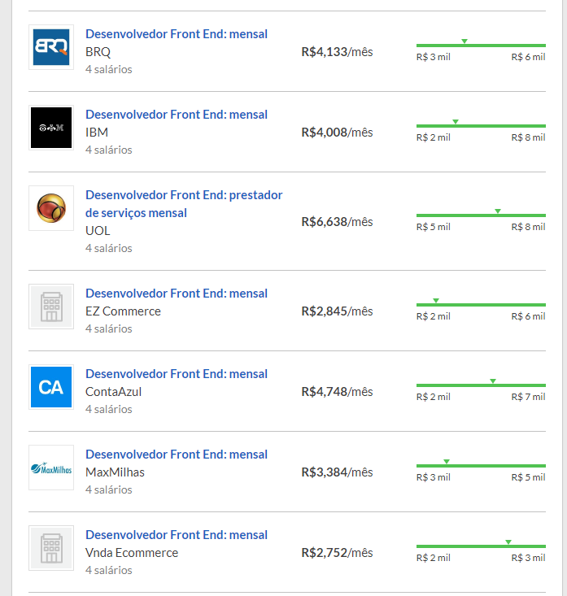
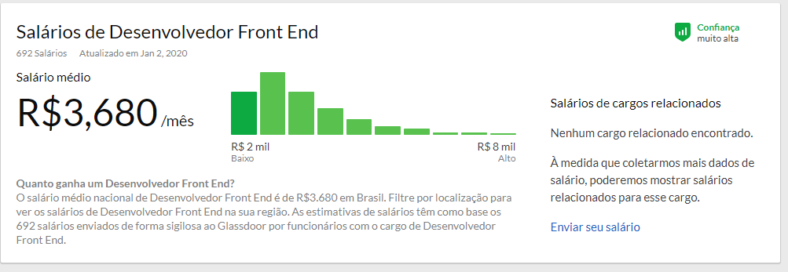
https://www.glassdoor.com.br/Sal%C3%A1rios/desenvolvedor-front-end-sal%C3%A1rio-SRCH_KO0,23.htm

Slide 24


Slide 25
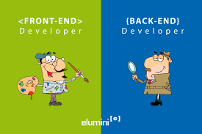

Slide 26


Slide 27

QUAL O TAMANHO DO SEU APETITE PARA O SUCESSO?

Slide 28


